Slide 1


SRI VENKATESWARA COLLEGE OF ENGINEERING AND
TECHNOLOGY(AUTONOMOUS)
RVS NAGAR,CHITTOOR,ANDHRAPRADESH
UNDER THE GUIDENCE OF
MR P NANDAKUMAR
DEPARTMENT OF IT
Neurological Disorder Risk
Prediction System
Team 3
CH.MANJULA(21781A1210)
J.BHANU SREEKRISHNA(21781A1218)
P.SAMAGNA(21781A1232)
P.AKHIL(21781A1233)
B.SAI KIRAN(22785A1202)

Slide 2
Abstract
The system predicts the risk of neurological disorders using machine learning.It analyzes medical data, symptoms, lifestyle, and genetics.
*The model employs the Random Forest algorithm, which achieves an accuracy of 90% in predicting the likelihood of neurological disorders.
*The primary objective is to support healthcare professionals in early diagnosis and decision-making, thereby enhancing diagnostic accuracy and reducing the risk of misdiagnosis.
*Additionally, the system's ability to process complex, multidimensional data makes it a promising tool for both individual healthcare and large-scale public health applications.

Slide 3
Problem Statement
Neurological disorders such as Alzheimer’s, Parkinson’s, stroke, and epilepsy are leading causes of disability and death worldwide. Early detection is crucial because neurological damage is often irreversible. However, current diagnostic methods face significant limitations:
High Costs and Limited Accessibility: Tools like MRI and EEG are expensive and not widely available, especially in rural or low-income areas.
Slow and Subjective Diagnosis: Traditional diagnosis relies on patient-reported symptoms and physician observations, leading to delays and variability.
Late Detection and Misdiagnosis: Patients often seek help only after severe symptoms appear, increasing the risk of misdiagnosis and reducing treatment effectiveness.

Slide 4
EXISTING SYSTEM
Current methods used for diagnosing neurological disorders include:
Imaging Techniques:
MRI (Magnetic Resonance Imaging) and CT (Computed Tomography) scans are used to detect structural abnormalities in the brain.
These tools are effective but expensive and not widely accessible.
EEG (Electroencephalography):
Monitors electrical activity in the brain, commonly used for diagnosing epilepsy.
Interpretation can be difficult without clear symptoms and requires expert evaluation.
Symptom-Based Diagnosis:
Relies on physician observations and patient-reported symptoms like memory loss or tremors.
This approach is subjective and often leads to delayed diagnosis.

Slide 5
PROPOSED SYSTEM
The project proposes an AI-powered Neurological Disorder Risk Prediction System that uses machine learning algorithms to predict a patient’s risk level before severe symptoms develop.
Key Components of the Proposed System:
Input Data Sources:
Patient Medical History: Previous illnesses, treatments, family history of neurological disorders.
Lifestyle Factors: Smoking, alcohol consumption, diet, exercise habits.
Genetic History: Hereditary predispositions to neurological conditions.
Symptom Scores: Clinical assessments and self-reported symptoms.
Risk Classification:
Patients are classified into low, medium, or high risk categories based on the input data.
Helps healthcare professionals decide on early interventions, further testing, or monitoring.

Slide 6
ADVANTAGES
- ✅ Advantages of the Project
Predictive Power: Accurately predicts neurological disorder risks using AI, enabling early intervention.
Affordable Healthcare Solution: Reduces the dependency on expensive diagnostic tools, making healthcare more accessible.
Time-Saving: Automates risk analysis and speeds up the diagnosis process.
Data-Driven Decisions: Provides objective insights for doctors, reducing human error.
Wide Applicability: Can be used in rural areas, clinics, and hospitals alike.
Supports Personalized Medicine: Uses patient-specific data to provide tailored risk assessments.

Slide 7
DISADVANTAGES
The project follows a structured machine learning pipeline to develop the Neurological Disorder Risk Prediction System:
1. Data Collection
Patient data including:
Demographics (age, gender, ethnicity)
Medical history (diagnoses, family history)
Lifestyle (smoking, alcohol, exercise, diet)
Clinical test results (MRI, EEG, cognitive scores
2. Data Preprocessing
Handling Missing Data: Using mean/median/mode imputation
Normalization/Standardization: To scale numerical features
Encoding: Convert categorical variables (e.g., gender, habits) to numeric
Train-Test Split: 80% for training, 20% for testing
Cross-validation: 5-fold for stable performance

Slide 8
3. Feature Selection
Extract key features like:
Age, symptom scores, test results, family history
Remove irrelevant or redundant data to improve model efficiency
4. Model Training
Machine learning models used:
Random Forest
Logistic Regression
Support Vector Machine (SVM)
Neural Networks
XGBoost
Each model trained using labeled patient data
5. Hyperparameter Tuning
Models optimized using techniques like:
Grid Search
Random Search
Parameters (e.g., tree depth, learning rate) adjusted for best performance

Slide 9

6. Model Evaluation
Metrics used:
Accuracy
Precision
Recall
F1-Score
AUC-ROC
Evaluate on test set to ensure generalization and reliability
7. Result Analysis
Neural Network performed best (88.9% accuracy, 90.1% recall)
Random Forest and XGBoost showed good balance between accuracy and interpretability

Slide 10
DATA SET DESCRIPTION
The project uses two main datasets containing patient health information to train and test the Neurological Disorder Risk Prediction System.
1. Neurological Disease Risk Dataset
Purpose: General risk classification
Features Include:
Demographics: Age, gender, ethnicity
Medical History: Prior conditions, family history
Lifestyle Habits: Smoking, alcohol, exercise, diet
Clinical Tests: MRI/EEG data, cognitive test scores
Risk Label: Low / Medium / High (target variable)
Source: Public health data repositories (e.g., Kaggle, medical institutes)
Size: Includes thousands of records
2. Clinical Test Dataset
Purpose: Focuses on test-specific prediction accuracy
Features Include:
MRI scan interpretations
EEG results
Blood test indicators
Cognitive assessment scores
Binary output: At Risk / Not At Risk
Size: 10,000+ patient entries
Data Type: Mix of numerical and categorical values

Slide 11
HARDWARE REQUIREMENTS
Component | Specification
Processor | Intel i7 (8-core)
RAM | 32 GB
GPU | NVIDIA GeForce RTX 3060
Storage | 1 TB SSD
SOFTWARE REQUIREMENTS
Category | Tools/Libraries Used
Programming Language | Python 3.8
Data Handling | NumPy, Pandas
Machine Learning | Scikit-learn, XGBoost
Deep Learning | TensorFlow, Keras
Visualization | Matplotlib, Seaborn
Development Env. | Jupyter Notebook

Slide 12
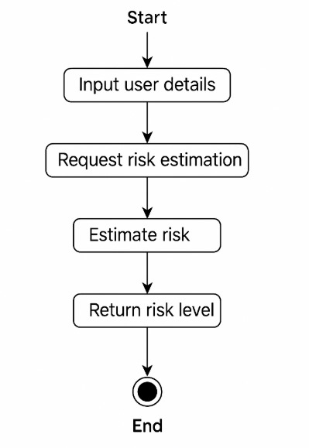
UML DIAGRAMS
Activity Diagram

Slide 13
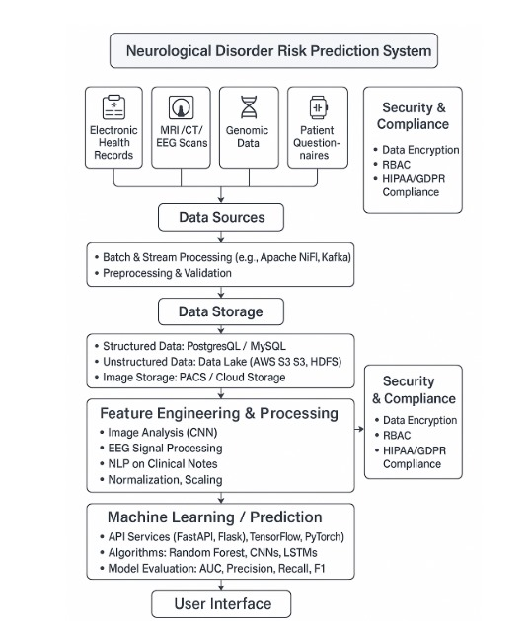
Architectural Diagram

Slide 14
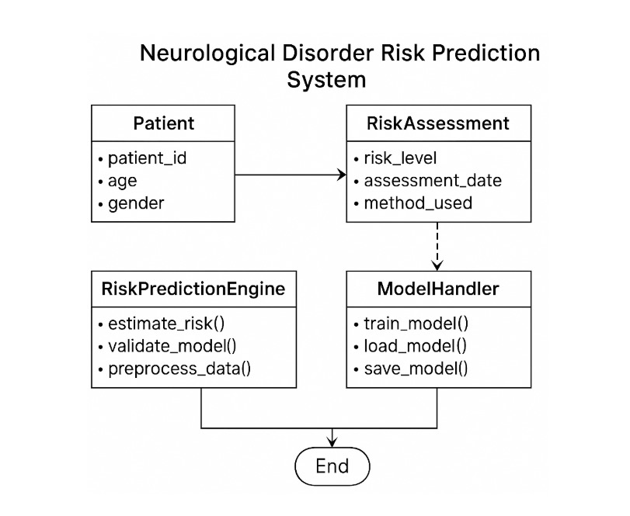
Class Diagram

Slide 15
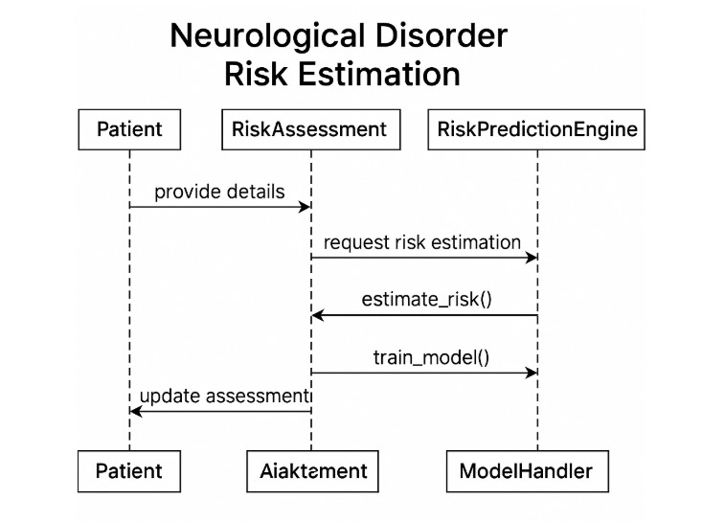
Sequence Diagram

Slide 16
ALGORITHMS USED
1. Random Forest
Type: Ensemble learning (uses multiple decision trees)
Why Used:
Handles missing or noisy data well
Reduces overfitting
High accuracy and interpretability
Performance: One of the top-performing models
2. Logistic Regression
Type: Statistical classification (binary or multi-class)
Why Used:
Simple and fast
Good for linear relationships
Outputs probability scores
Performance: Moderate accuracy, highly interpretable

Slide 17
3. Support Vector Machine (SVM)
Type: Supervised classification
Why Used:
Effective in high-dimensional spaces
Good for small to medium datasets
Works with linear and non-linear data
Performance: Solid results, but not the top performer
4. Neural Networks
Type: Deep learning
Why Used:
Learns complex, non-linear relationships
Great for large datasets and medical imaging
High flexibility and performance
Performance: Best accuracy (88.9%) and recall (90.1%)
5. XGBoost (Extreme Gradient Boosting)
Type: Gradient boosting ensemble
Why Used:
Fast and efficient
Excellent performance on structured/tabular data
Handles missing data and class imbalance well
Performance: Very close to Neural Networks in accuracy and precision

Slide 18
System Testing
System testing was done to validate the performance and reliability of the Neurological Disorder Risk Prediction System. This ensured that the machine learning models could generalize well to unseen patient data.
✅ Testing Methods Used
1. Train-Test Split
80% of the dataset was used for training, and 20% for testing.
Ensured the models were evaluated on unseen data.
2. Cross-Validation (5-Fold)
Dataset split into 5 parts; each part used as a test set once while the others are used for training.
Improves reliability and reduces the risk of biased results.
Testing Outcome
Neural Network: Best performance (88.9% accuracy, 90.1% recall)
Random Forest & XGBoost: Strong and interpretable results
SVM & Logistic Regression: Acceptable but lower performance

Slide 19
Test Cases
Test Case ID | Test Description | Input | Expected Output | Result Type
TC01 | Test with complete valid patient data | Age: 65, Smokes: Yes, Family History: Yes, Symptoms: High | Risk Level: High | Functional
TC02 | Test with low-risk patient profile | Age: 30, Active Lifestyle, No family history, Symptoms: None | Risk Level: Low | Functional
TC03 | Test handling of missing values in input | Age: 55, Smoking: —, Family History: Yes | Model imputes missing values and predicts | Data Handling
TC04 | Test categorical feature encoding | Gender: Male, Smoker: No | Features are correctly encoded numerically | Data Preprocessing
TC05 | Test boundary age value (e.g., young patient) | Age: 18, No medical history or symptoms | Risk Level: Low | Edge Case
TC06 | Test with noisy data (irrelevant characters/symbols) | Symptoms: “Tremor@@@” | Cleaned input, accurate prediction | Input Validation
TC07 | Evaluate model prediction accuracy on known test case | Pre-labeled patient data with known risk outcome | Model matches known label | Model Validation
TC08 | Test model scalability with large batch of inputs | 1000+ patient records uploaded | System handles load without failure | Performance Testing
TC09 | Test system security with unauthorized data access | Unauthorized API call or file upload | Access Denied / Error | Security
TC10 | Test prediction explainability (for interpretable models) | Patient record passed to Random Forest model | Returns risk + important contributing features | Interpretability

Slide 20
CONCLUSION
The Neurological Disorder Risk Prediction System successfully demonstrates how machine learning can be applied to predict the risk of neurological disorders like Alzheimer’s, Parkinson’s, stroke, and epilepsy using patient data.
Challenges Noted:
Deep learning models, while accurate, lack interpretability, which is important in clinical environments.
Success depends on data quality and diversity, which must be ensured for real-world deployment.
Final Thought:
This project contributes to the field of AI in healthcare, showcasing the potential of intelligent systems to enhance diagnostics, reduce costs, and improve patient outcomes, especially in resource-limited settings.

Slide 21
THANK YOU

